Slide 1

Exploratory Data Analysis
Beverage Forecasting Case Study

Slide 2

Agenda
Dataset Overview
EDA Summary
Recommendations

Slide 3


Dataset Overview

Slide 4
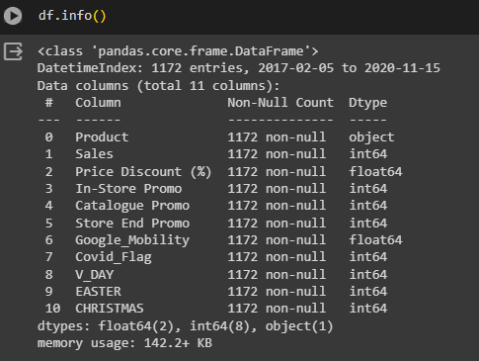

Slide 5
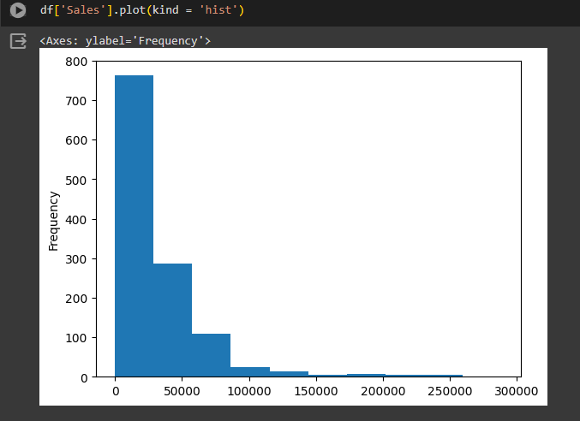
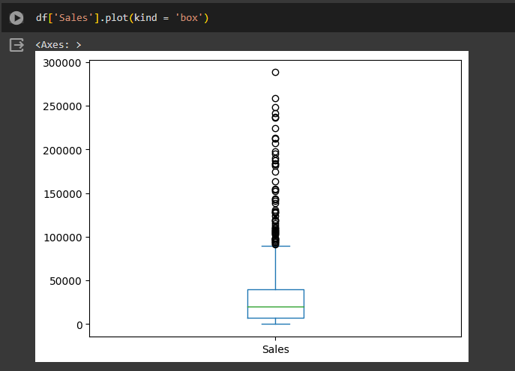
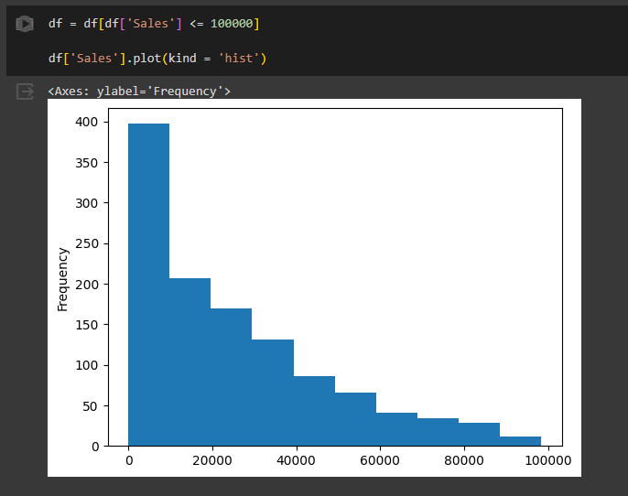
Sales Outlier Ananlysis

Slide 6
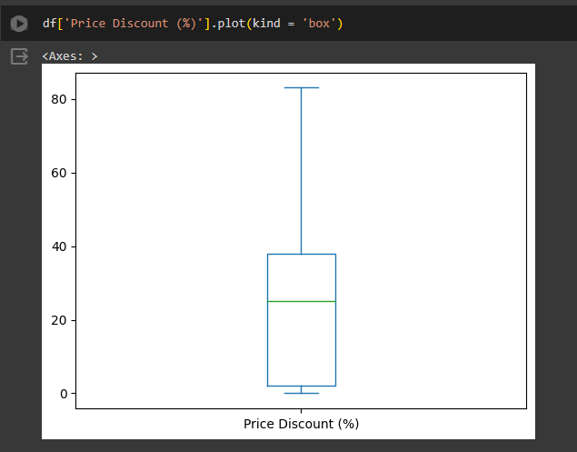

Outlier Analysis for other columns

Slide 7
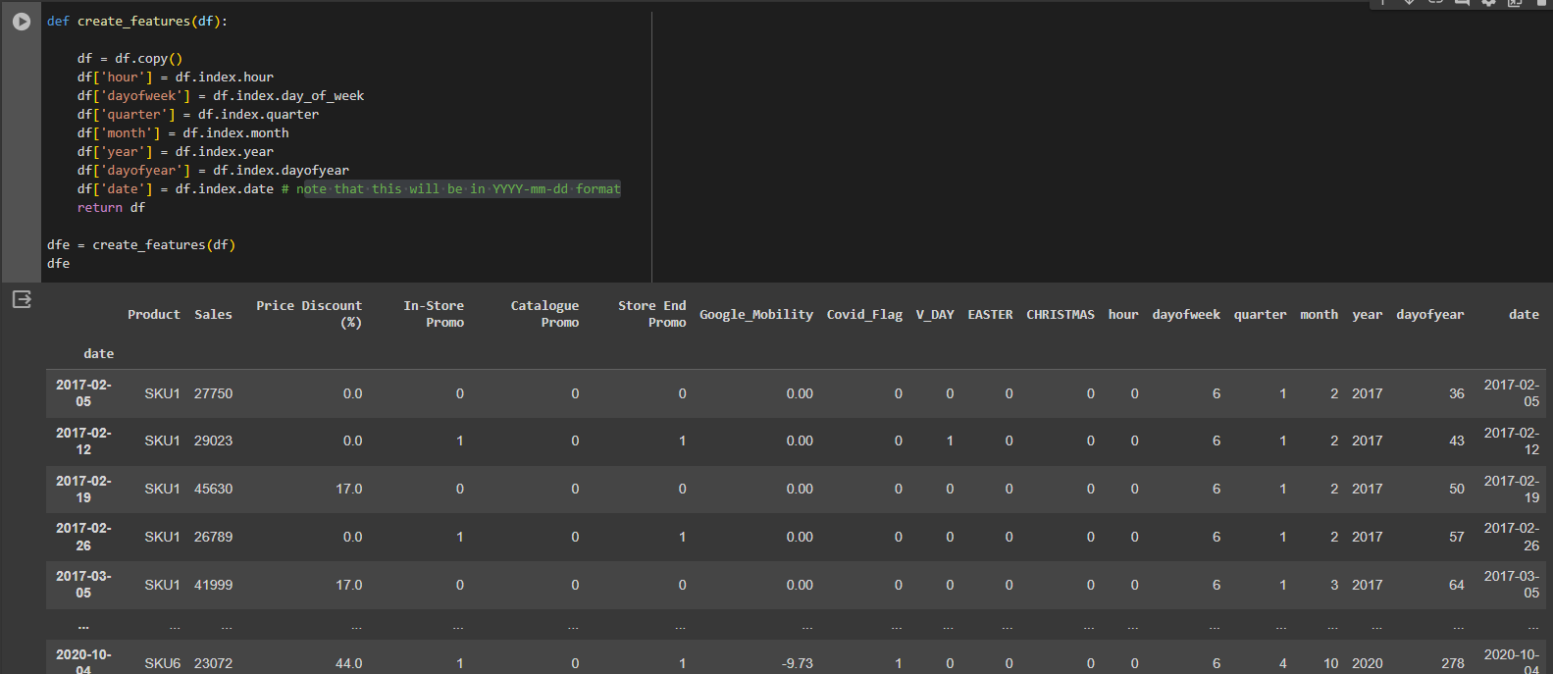
Creating new features

Slide 8
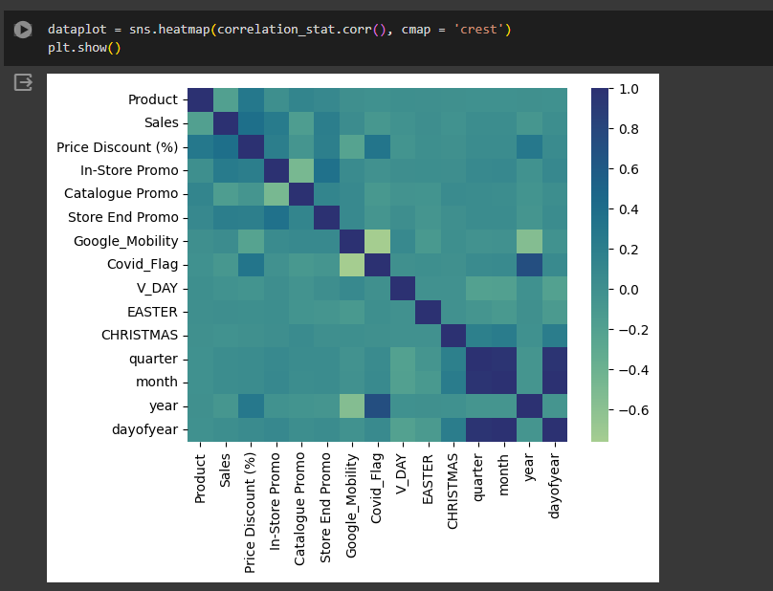
Correlation heatmap

Slide 9
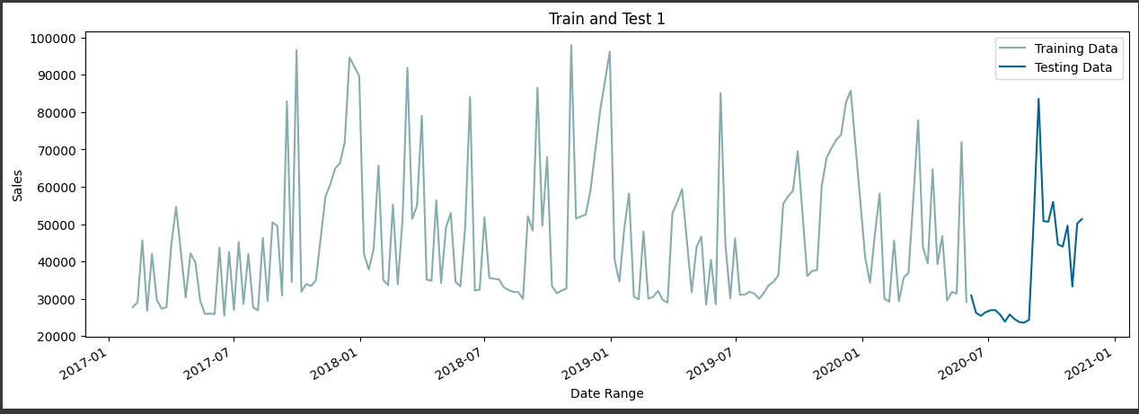
Training and Testing Data

Slide 10
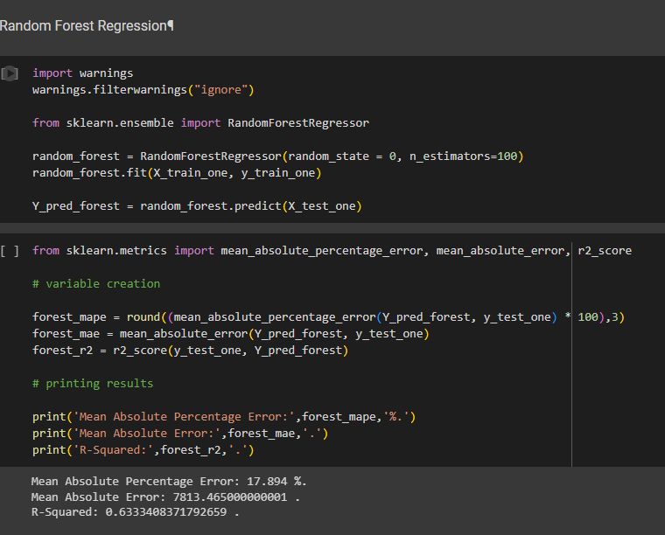
Model Recommendations- 1.Random Forest Regression

Slide 11
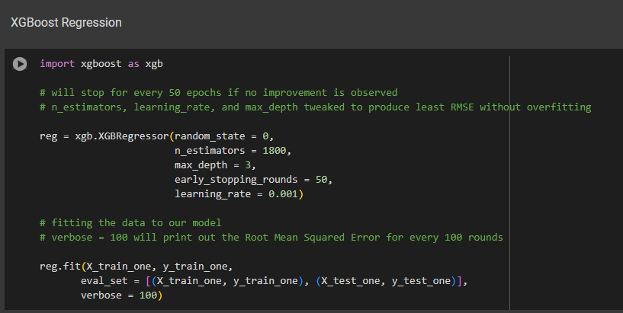
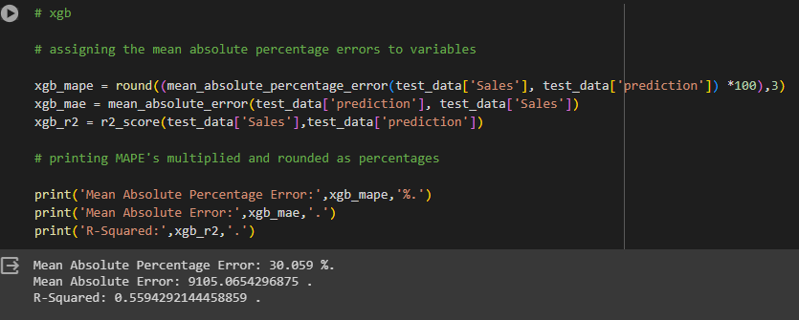
XGBoost

Slide 12
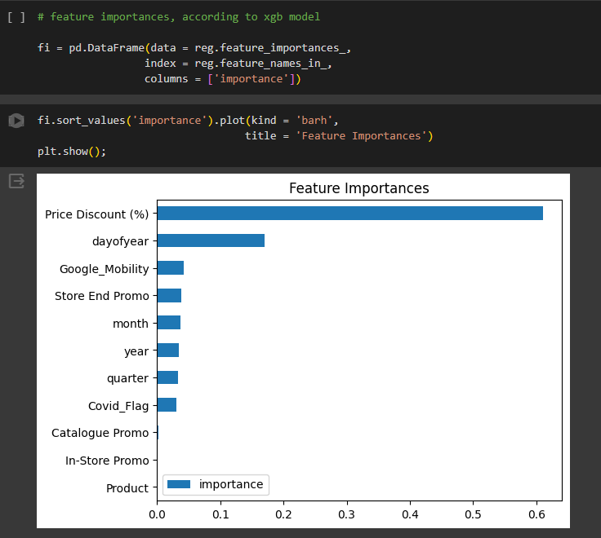
Feature Importance for XGBoost

Slide 13
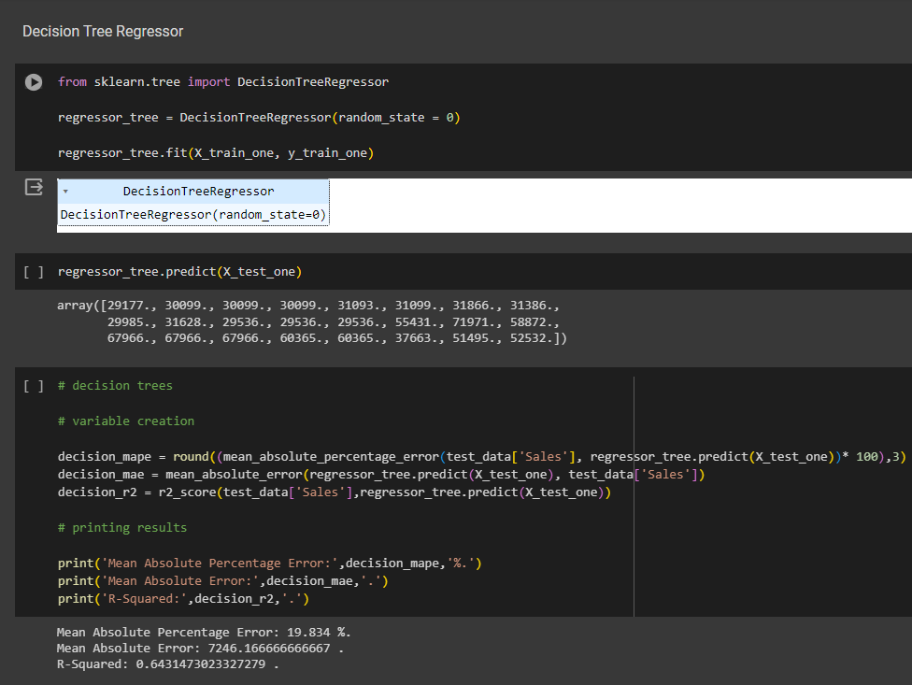
Decision Tree Regressor

Slide 14
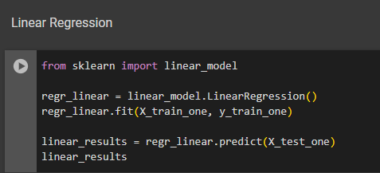
Linear Regression

Slide 15
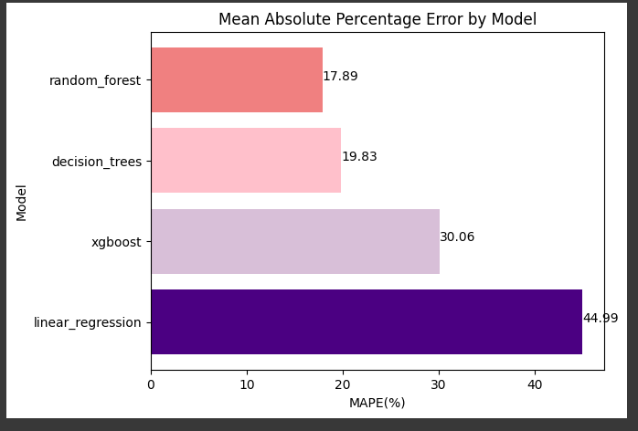
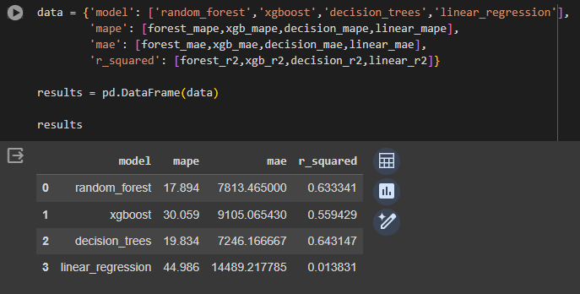
Model Evaluations

Slide 16
Thank You

